Slide 1
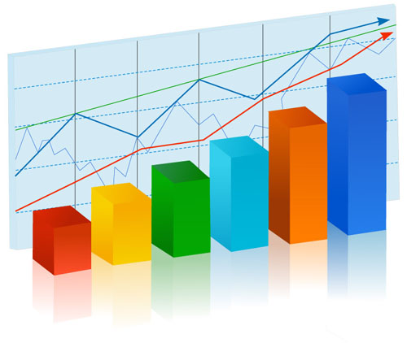
Statistics
The science of analyzing data
Yordan Darakchiev
Technical Trainer
iordan93@gmail.com

Slide 2
sli.do #MathForDevs

Slide 3
Table of Contents
Descriptive and inferential statistics
Population and sample
Properties of statistical distributions
Visualizing data
Covariance and correlation
Common misconceptions

Slide 4
Basic Concepts
How to deal with many numbers

Slide 5
Descriptive Statistics
Numbers which are used to summarize and describe data
We work with all items of interest – statistical population
We don’t try to make predictions, just describe what we’re seeing
Not very useful on their own
But an important part of other methods
Example: pet shop sales
100 pets in one month: 40 dogs, 30 cats, 30 other
What percent of all pets are dogs?
What's the mean number of cats sold per month?
We can also represent the information graphically
What does the distribution of dog sales per day look like?
What does the cumulative distribution of sales look like?
How do sales compare?

Slide 6
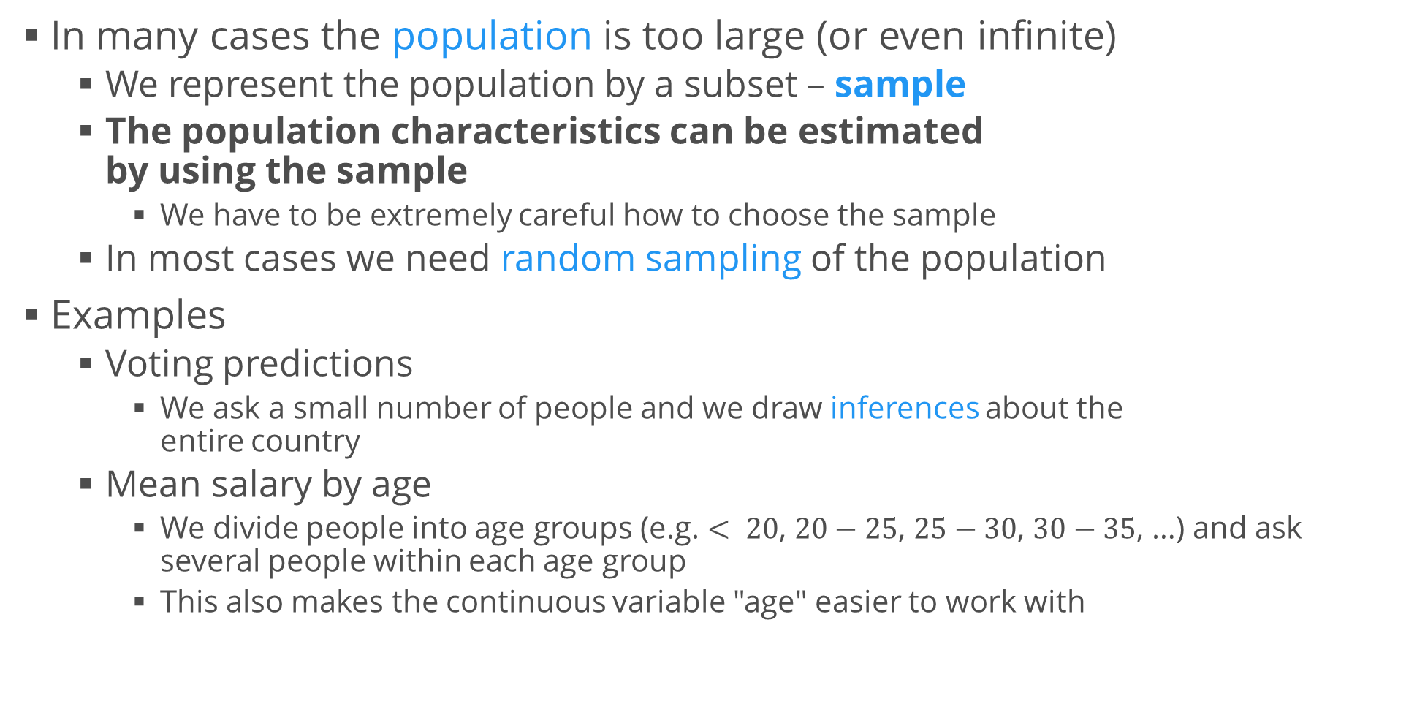
Inferential Statistics
In many cases the population is too large (or even infinite)
We represent the population by a subset – sample
The population characteristics can be estimated by using the sample
We have to be extremely careful how to choose the sample
In most cases we need random sampling of the population
Examples
Voting predictions
We ask a small number of people and we draw inferences about the entire country
Mean salary by age
We divide people into age groups (e.g. $< 20$, $20−25$, $25−30$, $30−35$, …) and ask several people within each age group
This also makes the continuous variable "age" easier to work with

Slide 7
Sampling
The process of selecting a sample from the population
Steps in the sampling process
Define the population
Specify the sampling frame – a set of items from the population
Specify the sampling method – how to select items from the frame
Determine the sample size
Implement the sampling and collect data
A badly done sampling can induce biases and errors
Selection bias – selecting a non-random sample
E.g., asking only CEOs of companies when sampling data for salaries by age
Random sampling error – random variations in the results

Slide 8
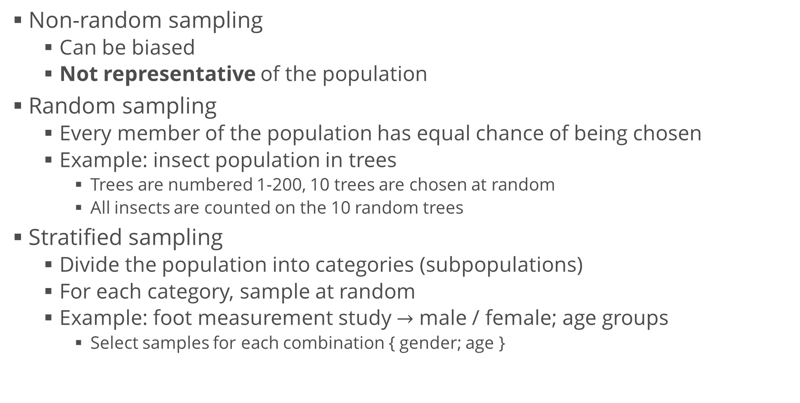
Sampling Methods
Non-random sampling
Can be biased
Not representative of the population
Random sampling
Every member of the population has equal chance of being chosen
Example: insect population in trees
Trees are numbered 1-200, 10 trees are chosen at random
All insects are counted on the 10 random trees
Stratified sampling
Divide the population into categories (subpopulations)
For each category, sample at random
Example: foot measurement study $→$ male / female; age groups
Select samples for each combination { gender; age }

Slide 9
Properties of Distributions
Mean, standard deviation, skewness, kurtosis

Slide 10
Summarizing Distributions
A histogram is a complete description of the sample distribution
We often summarize it using a few descriptive statistics
Central tendency
Do the values tend to cluster around a center?
Modes
How many clusters are there? Where are they?
Variance
How much variability is there (how "spread out" is the distribution)?
Tails
How quickly do probabilities drop off as we move away from the center(s)?
Outliers
Are there extreme values, far from the center(s)?
These are also called summary statistics

Slide 11
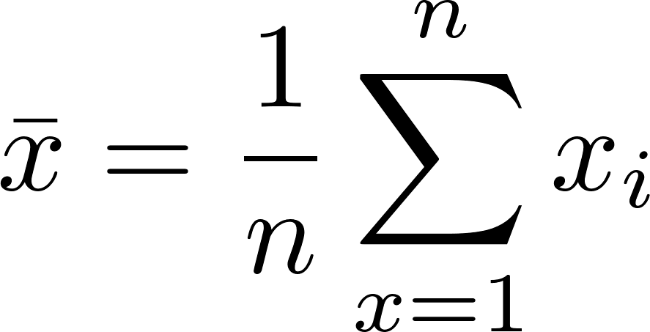
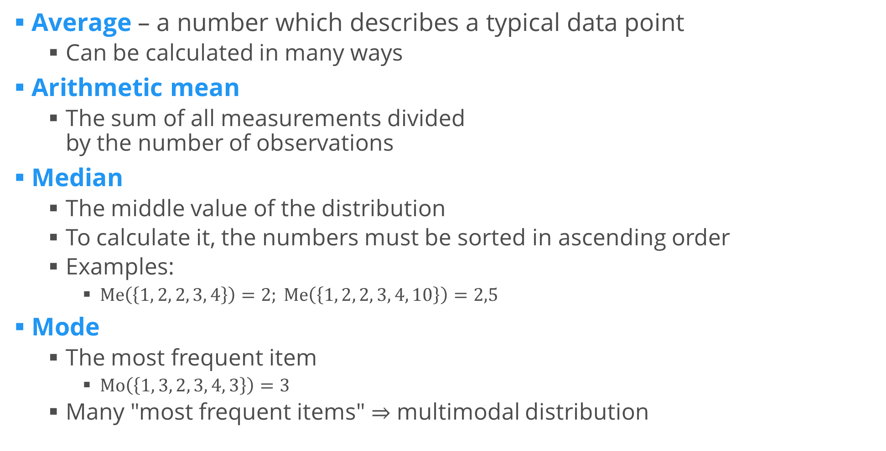
Measures of Central Tendency
Average – a number which describes a typical data point
Can be calculated in many ways
Arithmetic mean
The sum of all measurements divided by the number of observations
Median
The middle value of the distribution
To calculate it, the numbers must be sorted in ascending order
Examples:
$Me\left(\left\{1, 2, 2, 3, 4\right\}\right)=2; Me\left(\left\{1, 2, 2, 3, 4, 10\right\}\right)=2,5$
Mode
The most frequent item
$Mo\left(\left\{1, 3, 2, 3, 4, 3\right\}\right)=3$
Many "most frequent items" $⇒$ multimodal distribution

Slide 12
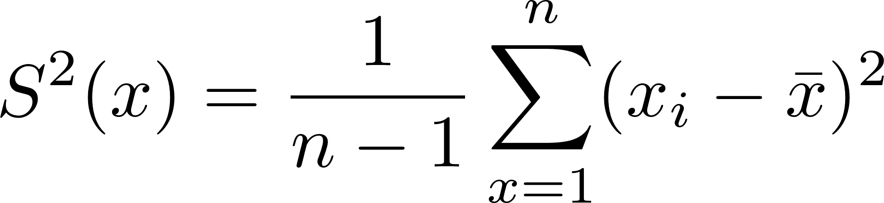
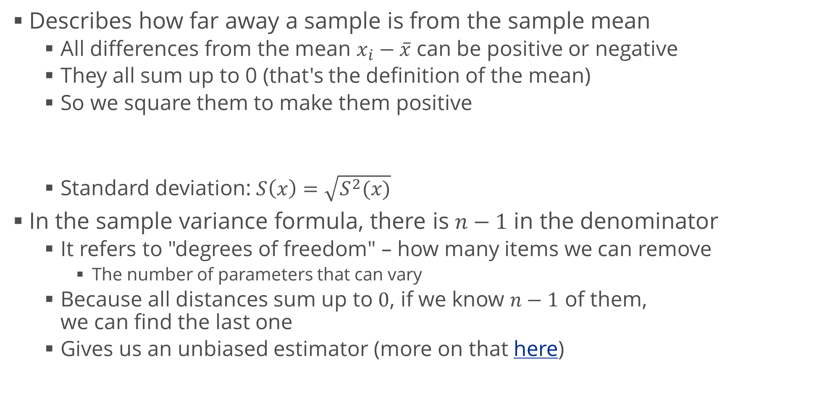
Variance
Describes how far away a sample is from the sample mean
All differences from the mean $x_{i}−\overline{x}$ can be positive or negative
They all sum up to 0 (that's the definition of the mean)
So we square them to make them positive
Standard deviation: $S\left(x\right)=\sqrt{S^{2}(x)}$
In the sample variance formula, there is $n−1$ in the denominator
It refers to "degrees of freedom" – how many items we can remove
The number of parameters that can vary
Because all distances sum up to $0$, if we know $n−1$ of them, we can find the last one
Gives us an unbiased estimator (more on that here)

Slide 13
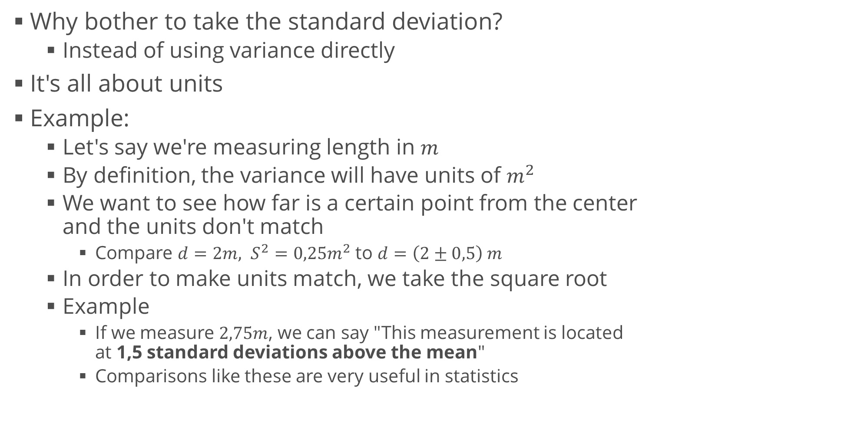
Variance (2)
Why bother to take the standard deviation?
Instead of using variance directly
It's all about units
Example:
Let's say we're measuring length in $m$
By definition, the variance will have units of $m^{2}$
We want to see how far is a certain point from the center and the units don't match
Compare $d=2m, S^{2}=0,25m^{2}$ to $d=\left(2±0,5\right) m$
In order to make units match, we take the square root
Example
If we measure $2,75m$, we can say "This measurement is located at 1,5 standard deviations above the mean"
Comparisons like these are very useful in statistics

Slide 14
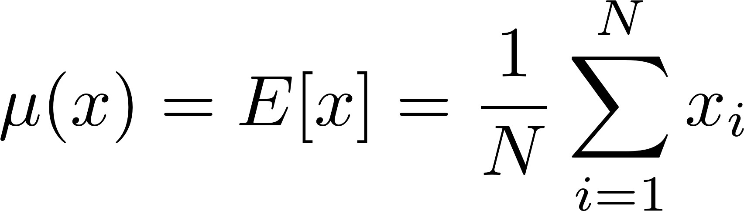
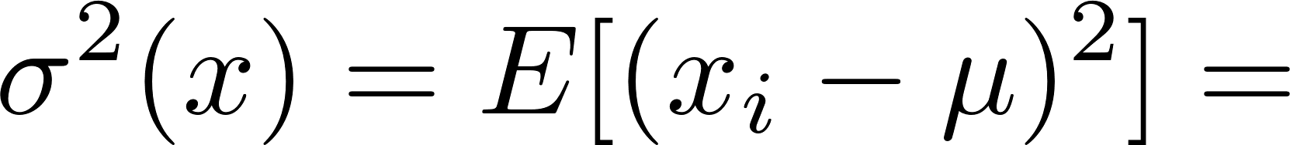
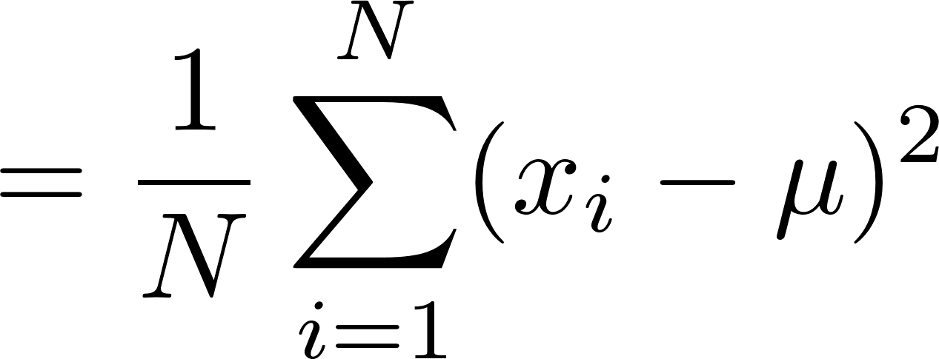
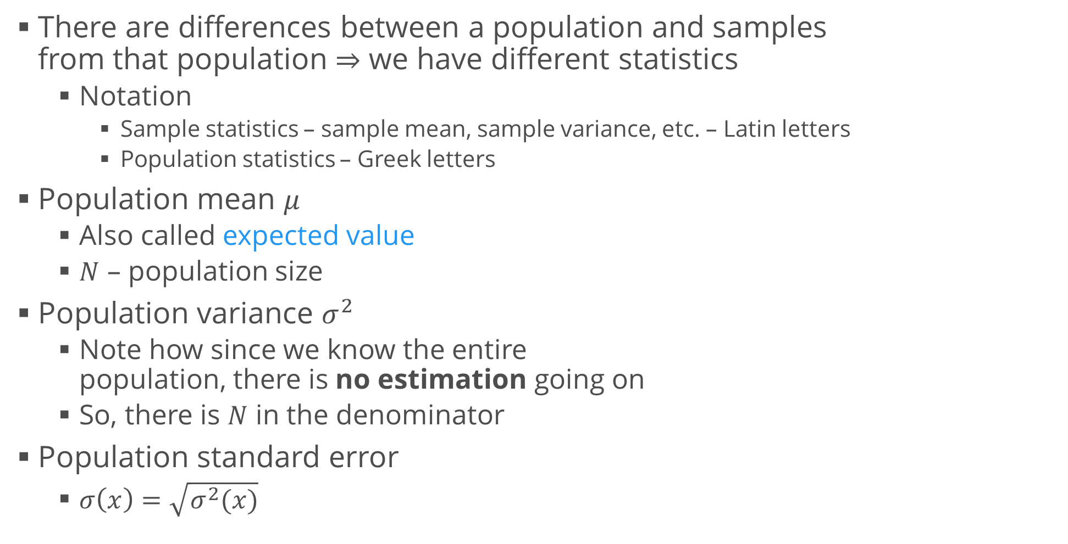
Population vs. Sample: Measures
There are differences between a population and samples from that population $⇒$ we have different statistics
Notation
Sample statistics – sample mean, sample variance, etc. – Latin letters
Population statistics – Greek letters
Population mean $μ$
Also called expected value
$N$ – population size
Population variance $σ^{2}$
Note how since we know the entire population, there is no estimation going on
So, there is $N$ in the denominator
Population standard error
$σ\left(x\right)=\sqrt{σ^{2}(x)}$

Slide 15
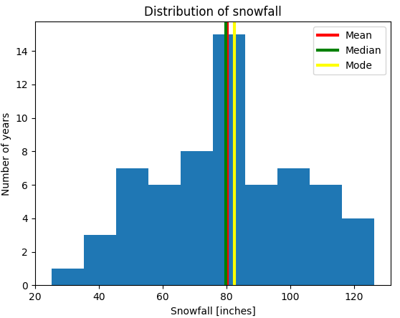
Example: Snowfall Data
You are given data of snowfall in Buffalo, NY in inches for years 1910 – 1972 (snowfall.csv)
Plot a histogram
Print the mean, standard deviation and modes
Print the standard deviation
Note: If you're using numpy, it returns the biased estimator of standard deviation. Pass a parameter ddof = 1 (difference in degrees of freedom) to calculate the unbiased estimator
Overlay the mean, median and first mode on the histogram

Slide 16
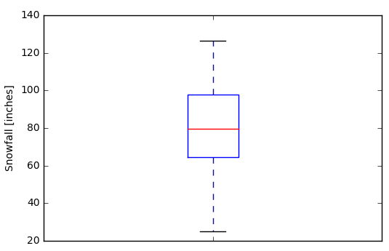
Five-Number Summary
Conveys similar information to a histogram
How many percent of the data are less than or equal to a specified number
Minimum (0%); first quartile (25%); median (50%); third quartile (75%); maximum (100%)
Generalization: quantiles – divide the frequency distribution into equal groups
100 groups = percentiles
Visualization: boxplot
Middle line – median
Box – quartiles
Whiskers – largest "non-outliers" – 1.5 times the interquartile range
Points – outliers

Slide 17
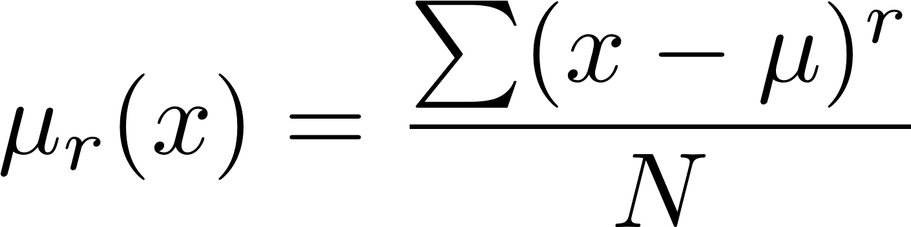
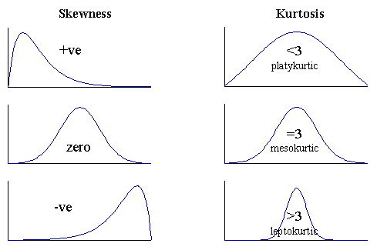
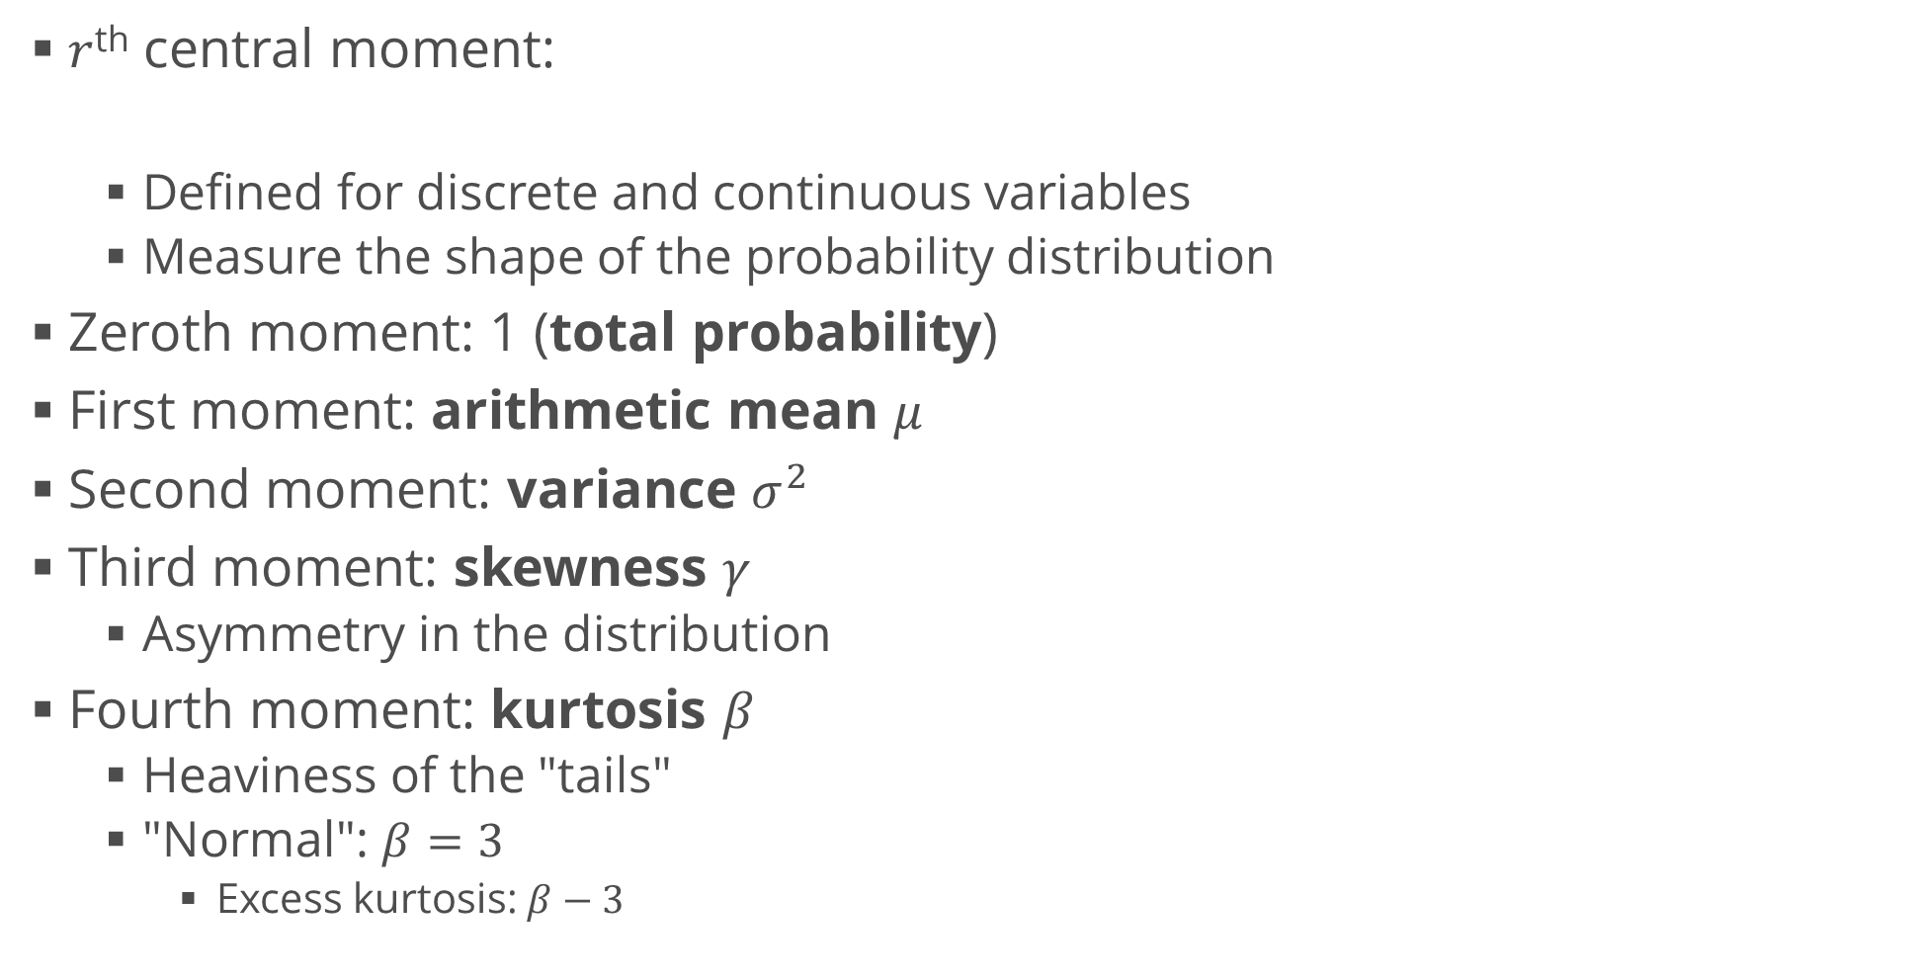
Moments of Distributions
$r$^{th} central moment:
Defined for discrete and continuous variables
Measure the shape of the probability distribution
Zeroth moment: 1 (total probability)
First moment: arithmetic mean $μ$
Second moment: variance $σ^{2}$
Third moment: skewness $γ$
Asymmetry in the distribution
Fourth moment: kurtosis $β$
Heaviness of the "tails"
"Normal": $β=3$
Excess kurtosis: $β−3$

Slide 18
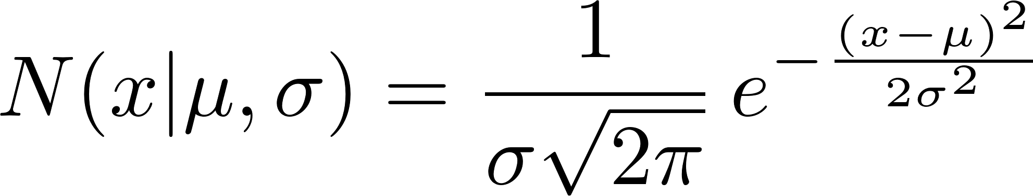
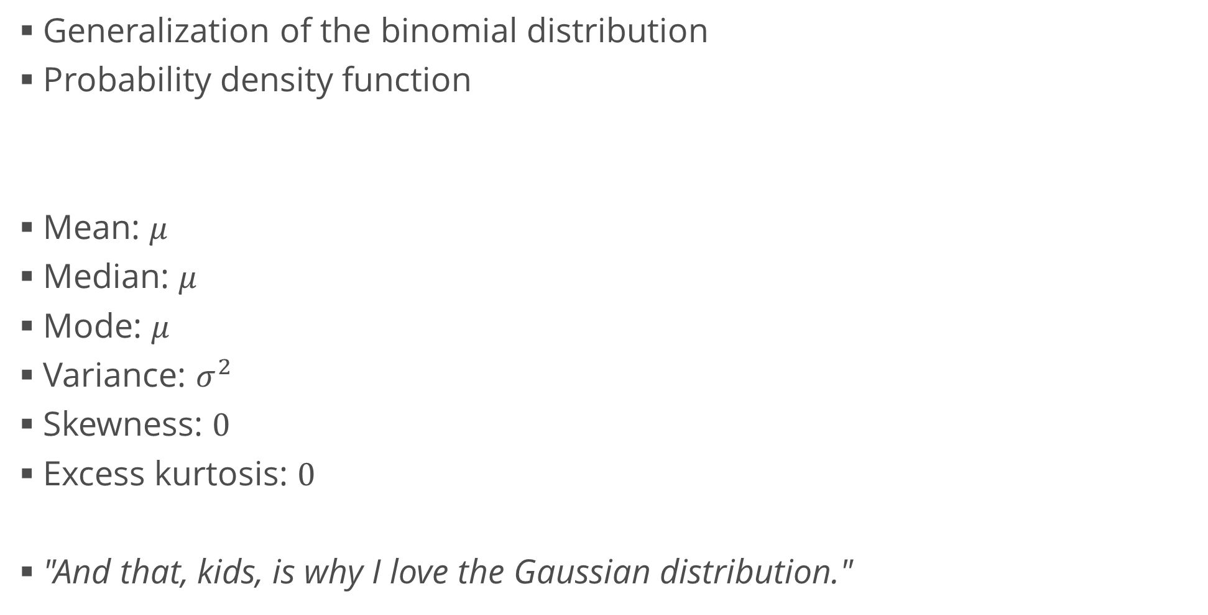
Moments of the Gaussian Distribution
Generalization of the binomial distribution
Probability density function
Mean: $μ$
Median: $μ$
Mode: $μ$
Variance: $σ^{2}$
Skewness: $0$
Excess kurtosis: $0$
"And that, kids, is why I love the Gaussian distribution."

Slide 19
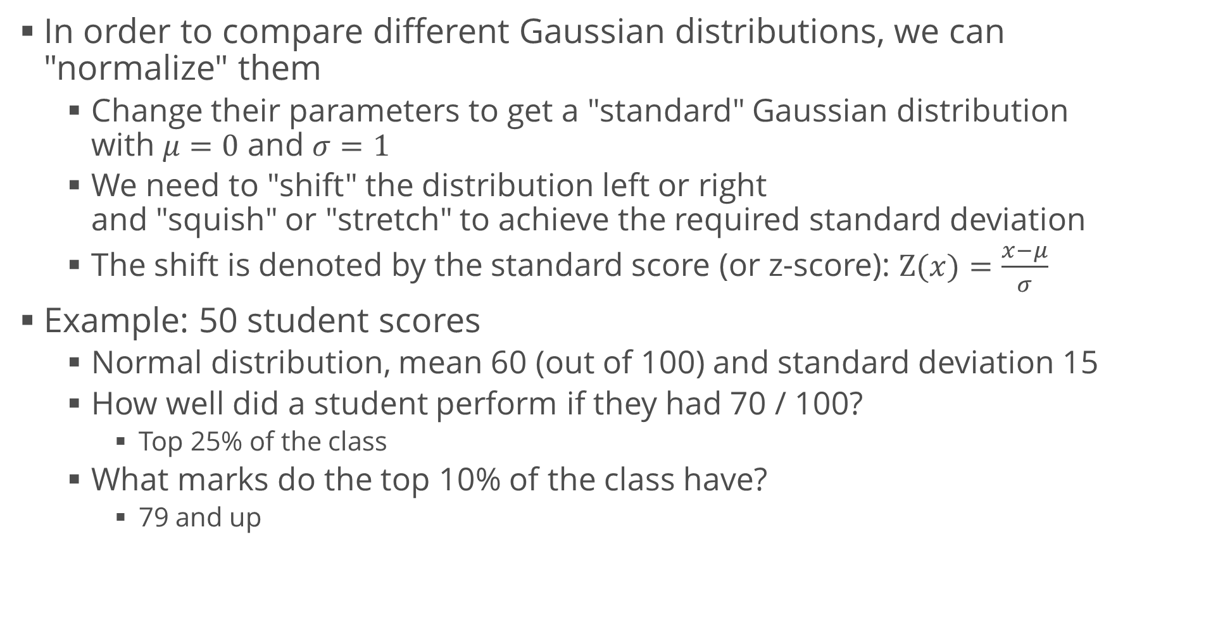
Standard Score
In order to compare different Gaussian distributions, we can "normalize" them
Change their parameters to get a "standard" Gaussian distribution with $μ=0$ and $σ=1$
We need to "shift" the distribution left or right and "squish" or "stretch" to achieve the required standard deviation
The shift is denoted by the standard score (or z-score): $Z(x)=\frac{x−μ}{σ}$
Example: 50 student scores
Normal distribution, mean 60 (out of 100) and standard deviation 15
How well did a student perform if they had 70 / 100?
Top 25% of the class
What marks do the top 10% of the class have?
79 and up

Slide 20
Many Variables
Extending what we know

Slide 21
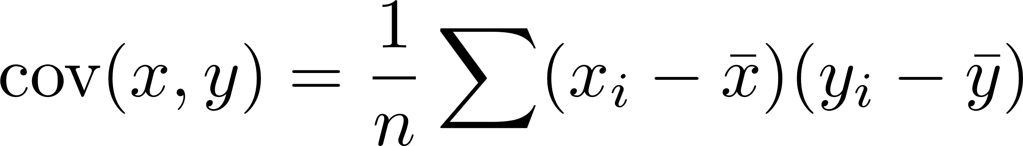
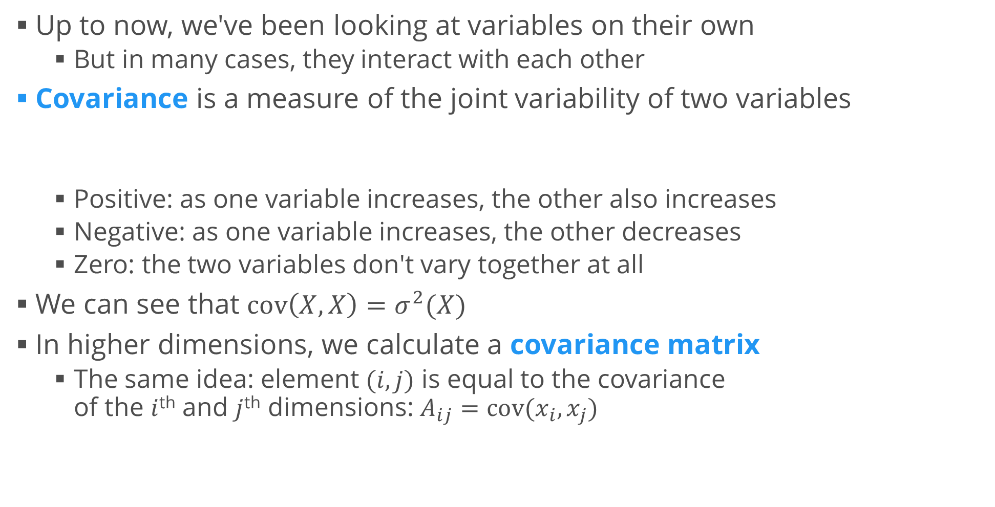
Covariance
Up to now, we've been looking at variables on their own
But in many cases, they interact with each other
Covariance is a measure of the joint variability of two variables
Positive: as one variable increases, the other also increases
Negative: as one variable increases, the other decreases
Zero: the two variables don't vary together at all
We can see that $cov\left(X,X\right)=σ^{2}(X)$
In higher dimensions, we calculate a covariance matrix
The same idea: element $(i, j)$ is equal to the covariance of the $i$^{th} and $j$^{th} dimensions: $A_{ij}=cov(x_{i}, x_{j})$

Slide 22
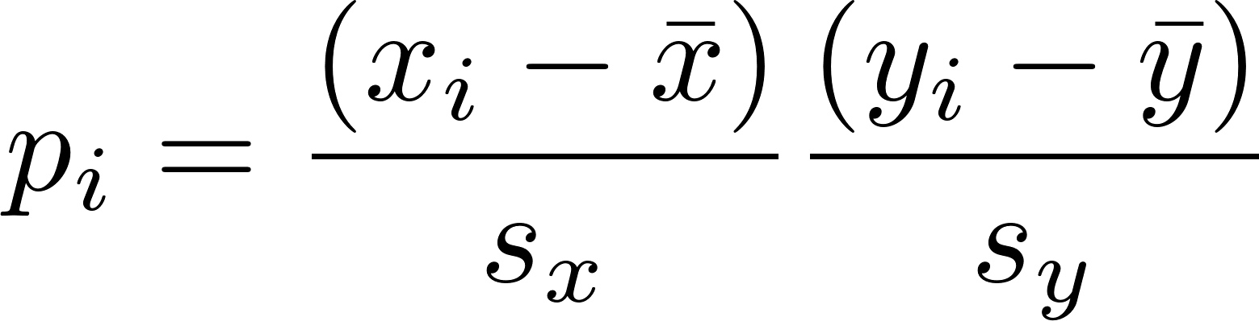
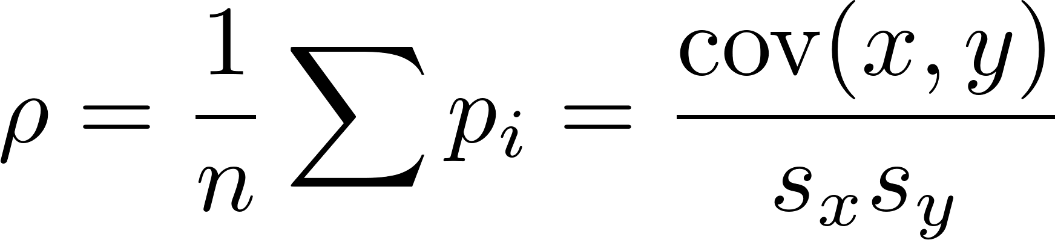
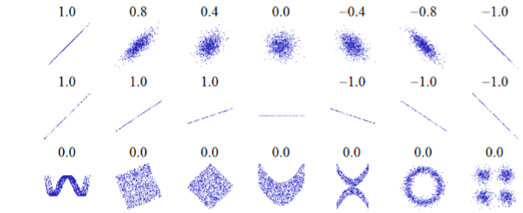
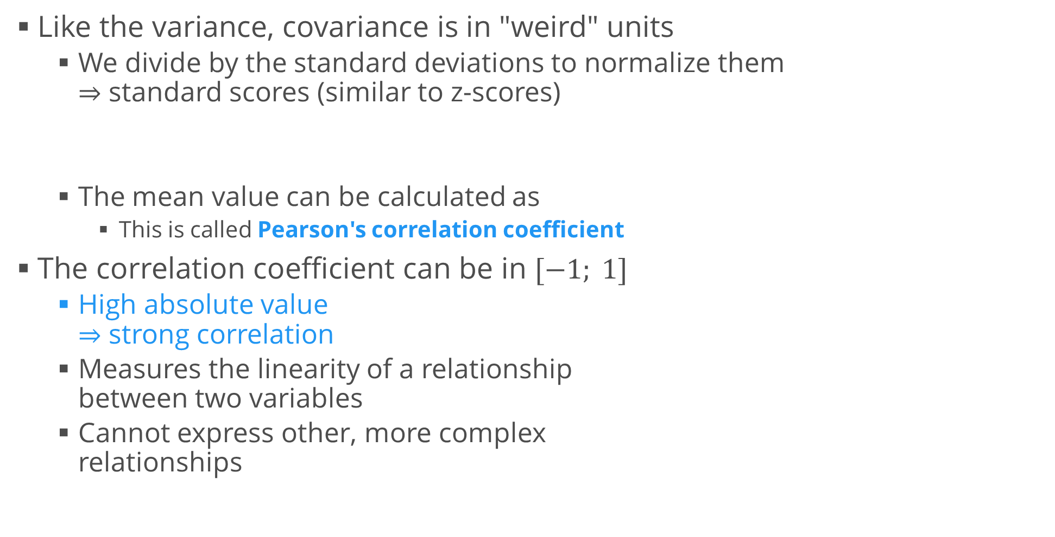
Correlation
Like the variance, covariance is in "weird" units
We divide by the standard deviations to normalize them $⇒$ standard scores (similar to z-scores)
The mean value can be calculated as
This is called Pearson's correlation coefficient
The correlation coefficient can be in $[−1; 1]$
High absolute value $⇒$ strong correlation
Measures the linearity of a relationship between two variables
Cannot express other, more complex relationships

Slide 23
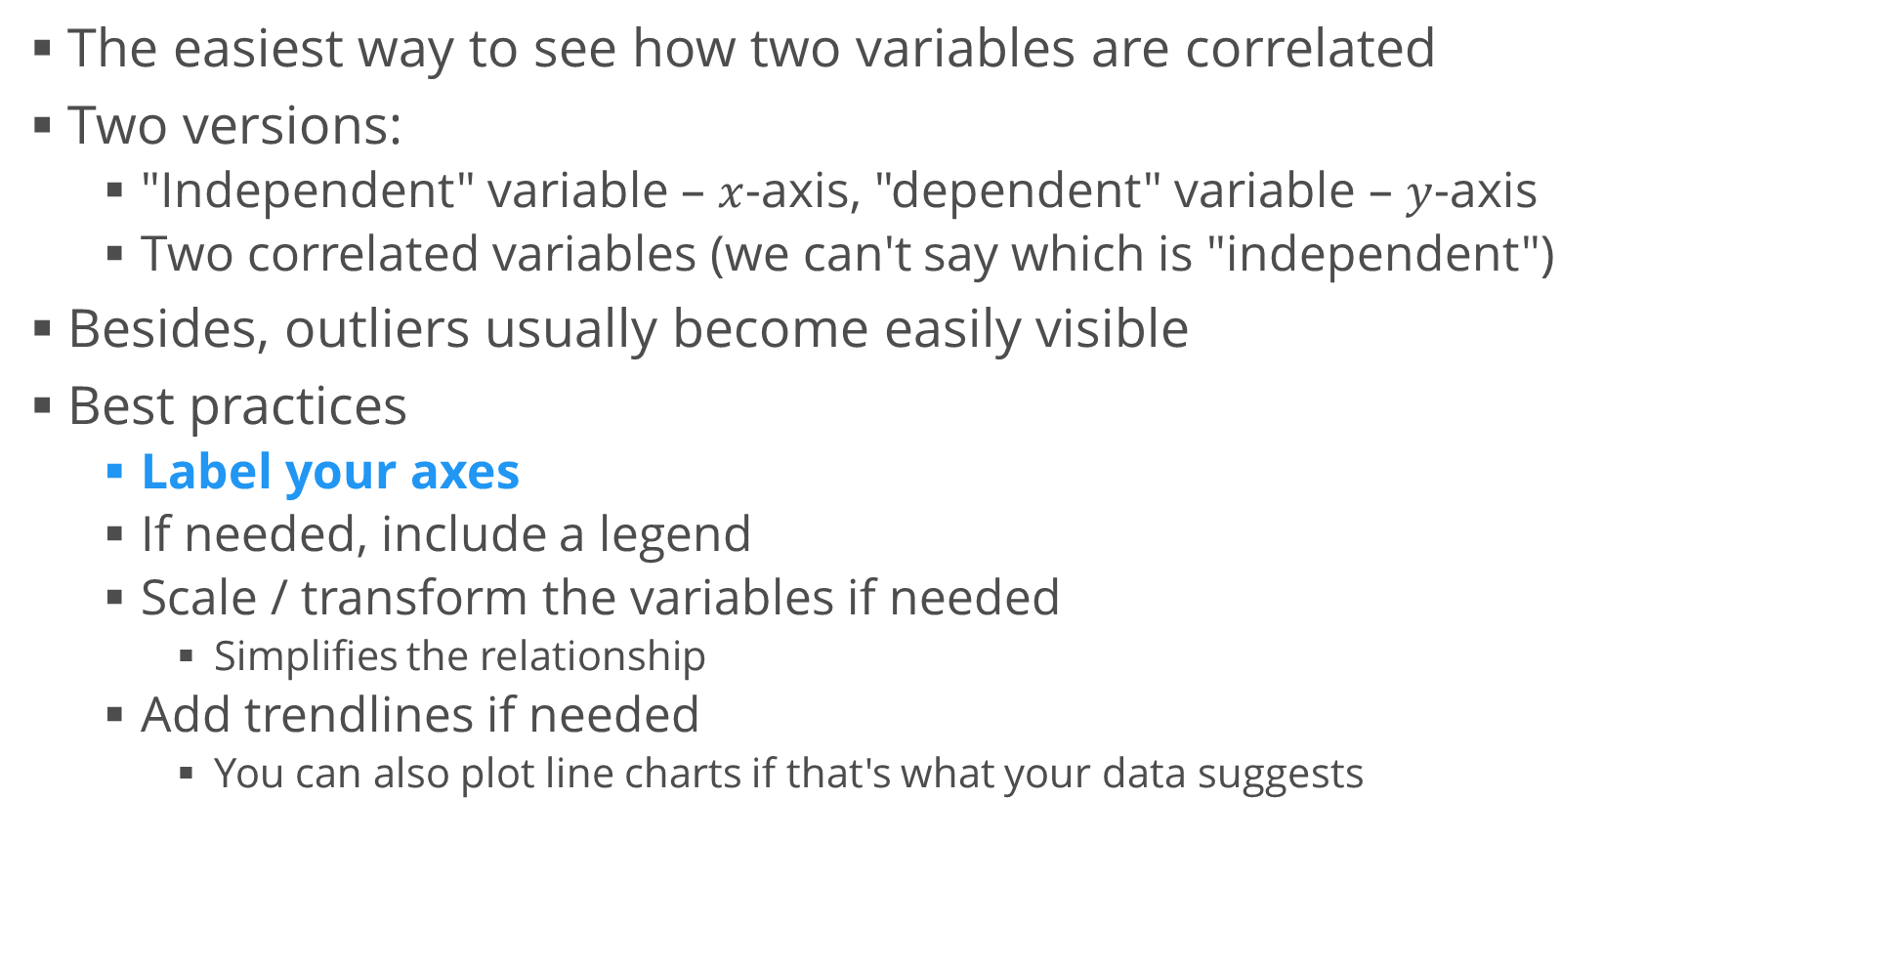
Scatter Plots
The easiest way to see how two variables are correlated
Two versions:
"Independent" variable – $x$-axis, "dependent" variable – $y$-axis
Two correlated variables (we can't say which is "independent")
Besides, outliers usually become easily visible
Best practices
Label your axes
If needed, include a legend
Scale / transform the variables if needed
Simplifies the relationship
Add trendlines if needed
You can also plot line charts if that's what your data suggests

Slide 24
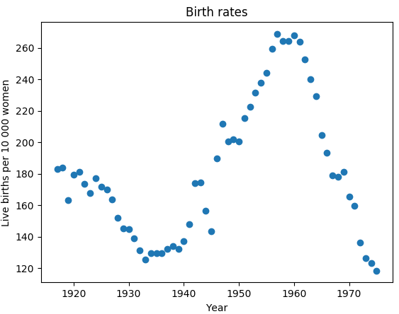
Example: Birth Rates
You are given the number of live births per 10 000 23-year-old women in the US between 1917 and 1975
File: birth_rates.csv
Plot a scatter plot of the birth rates per year
What conclusions can you make?
This is called "time series analysis" – we are analyzing a process as it evolves with time
Additionally, you can still inspect the variables one by one
Plot a histogram of the birth rates, disregarding the years
Are there any "typical" birth rates?
Are they distributed normally?

Slide 25
Example: Brain and Body Weights
File: brain_weight.csv
Inspect the two variables: body weight [kg], brain weight [g]
Plot histograms, even boxplots if needed
Create a scatterplot
The distribution is highly skewed, almost nothing is visible
Transform the data
Take logarithms of both the body weight and the brain weight
Plot histograms of the logarithms
Create another (log-log) scatterplot
Is there any significant relationship?
If so, what is the real relationship (between the untransformed variables)?
To find it, you have to "reverse" the transformation

Slide 26
Common Pitfalls
Statistics can be dangerous (and wrong)

Slide 27
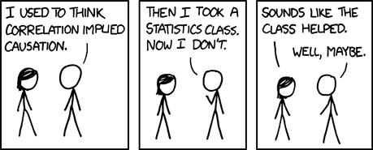
Correlation Does Not Imply Causation!
If two variables are correlated, this does not mean that necessarily the first causes the second
Example: height and weight
Does a greater weight cause a greater height?
We can still describe them
We can predict height from weight and vice versa
But that still does not say anything about one causing the other

Slide 28
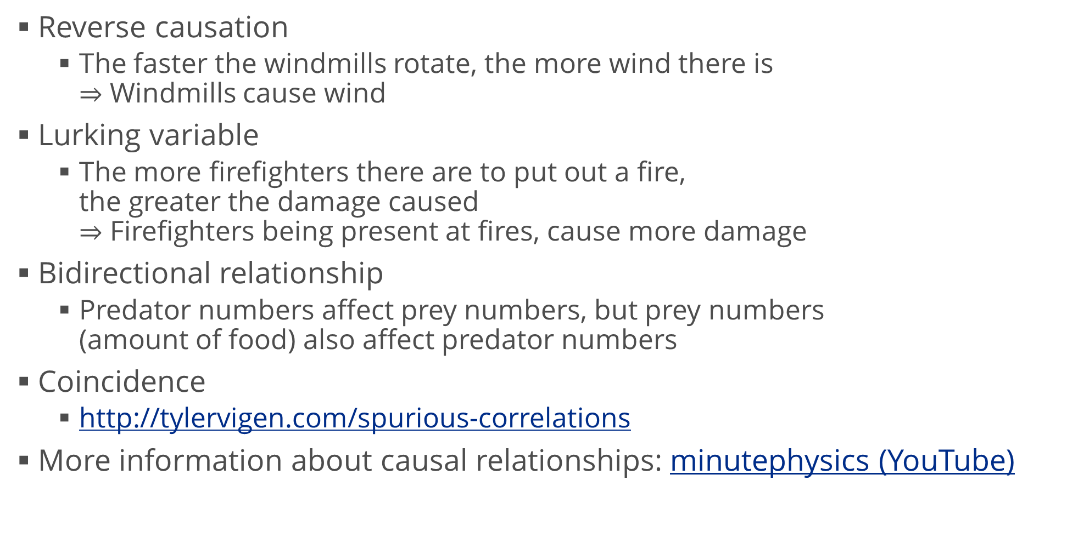
Correlation vs. Causation
Reverse causation
The faster the windmills rotate, the more wind there is $⇒$ Windmills cause wind
Lurking variable
The more firefighters there are to put out a fire, the greater the damage caused $⇒$ Firefighters being present at fires, cause more damage
Bidirectional relationship
Predator numbers affect prey numbers, but prey numbers (amount of food) also affect predator numbers
Coincidence
http://tylervigen.com/spurious-correlations
More information about causal relationships: minutephysics (YouTube)

Slide 29
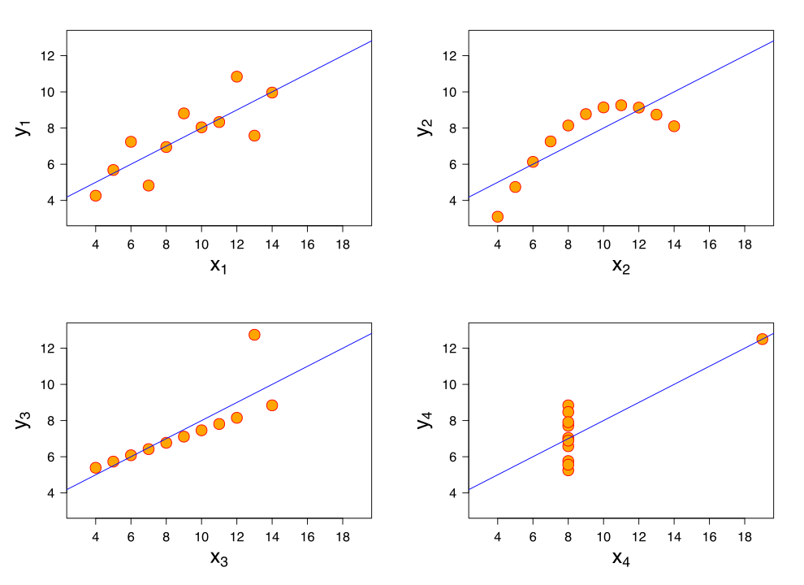
Anscombe’s Quartet
Four datasets with similar descriptive statistics which look completely different when plotted
More information: Wikipedia
Takeaways
Plot the data
In general, it’s important to get to know your data
List as many assumptions and simplifications as possible
Do not rely simply on a bunch of numbers
Even worse, a single number

Slide 30

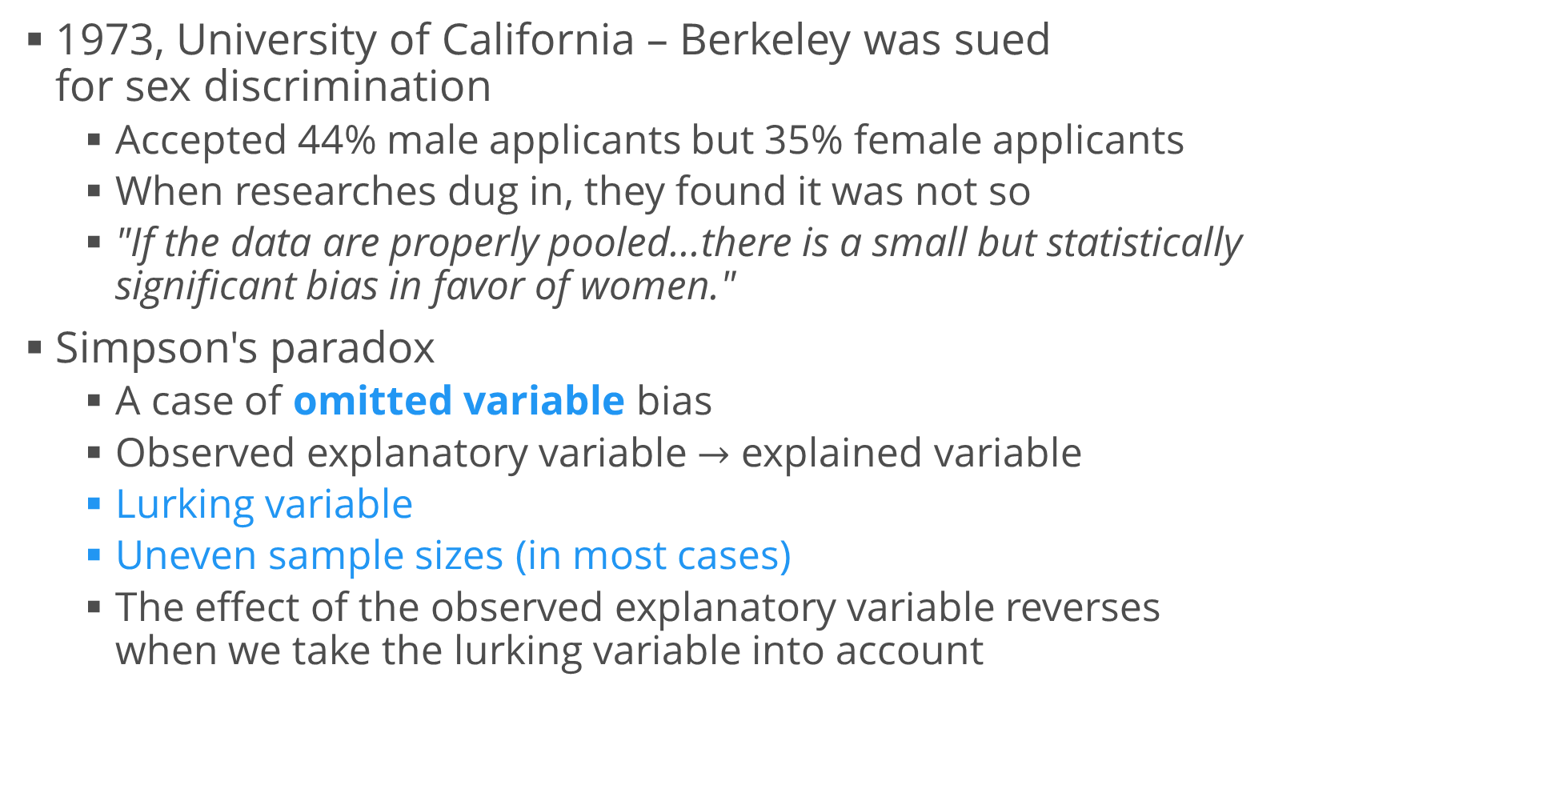
Simpson's Paradox
1973, University of California – Berkeley was sued for sex discrimination
Accepted 44% male applicants but 35% female applicants
When researches dug in, they found it was not so
"If the data are properly pooled...there is a small but statistically significant bias in favor of women."
Simpson's paradox
A case of omitted variable bias
Observed explanatory variable $→$ explained variable
Lurking variable
Uneven sample sizes (in most cases)
The effect of the observed explanatory variable reverses when we take the lurking variable into account

Slide 31
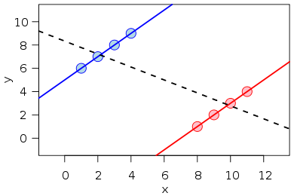
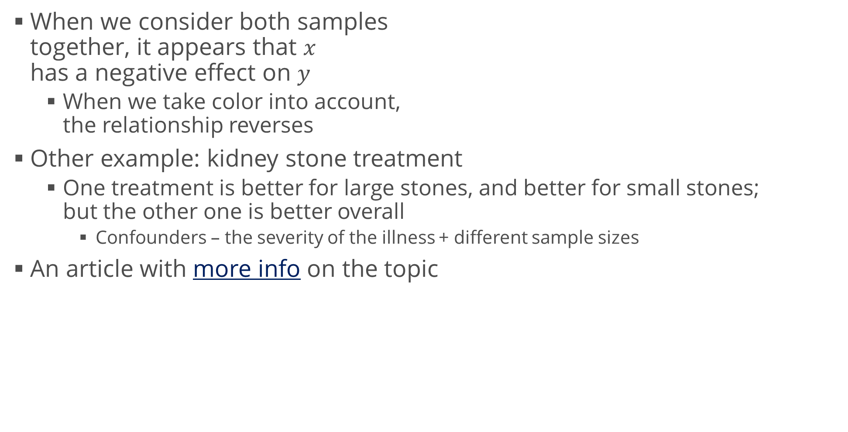
Simpson's Paradox (2)
When we consider both samples together, it appears that $x$ has a negative effect on $y$
When we take color into account, the relationship reverses
Other example: kidney stone treatment
One treatment is better for large stones, and better for small stones; but the other one is better overall
Confounders – the severity of the illness + different sample sizes
An article with more info on the topic

Slide 32
UCB Admissions – Explanation
The research paper concluded that 6 departments were significantly biased towards men and 4 – towards women
The other 75 weren't (significantly) biased at all
Actually, the overall bias was (slightly) in favor of women
Women tended to apply to competitive departments with low admission rates
Men tended to apply to less competitive departments with high admission rates
We cannot observe that directly from our dataset
Lurking variable – competitiveness
Students didn't have the same motivations to apply

Slide 33
Summary
Descriptive and inferential statistics
Population and sample
Properties of statistical distributions
Visualizing data
Covariance and correlation
Common misconceptions

